Slide 1










Welcome to TikZ
Tutorial # 1

Slide 2
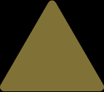
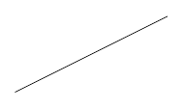

What is TikZ?
It defines a number of LATEX commands that draw graphics.
TikZ is probably the most complex and powerful tool to create graphic elements in LATEX.

Slide 3


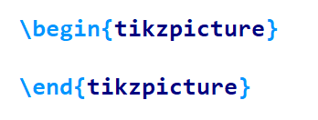
Usage

Slide 4
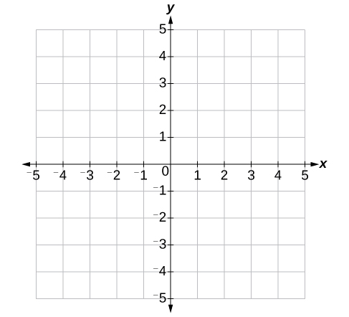
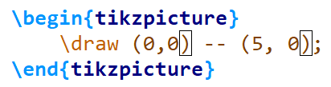

Draw A Horizontal Line
(0,0)
(5,0)

Slide 5
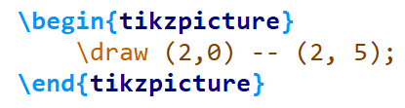

Draw A Vertical Line
(2,5)
(2,0)

Slide 6
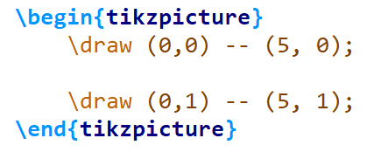

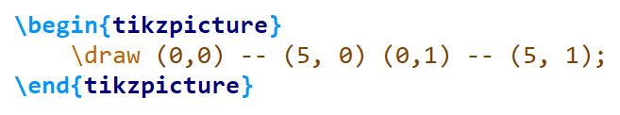
Draw Two Horizontal Lines
(0,1)
(5,1)
(0,0)
(5,0)

Slide 7
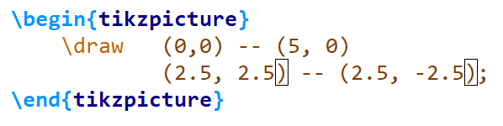

Draw A Plus Sign
(2.5, 2.5)
(0,0)
(5,0)
(2.5, -2.5)

Slide 8
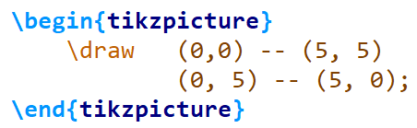

Draw A Cross Sign

Slide 9
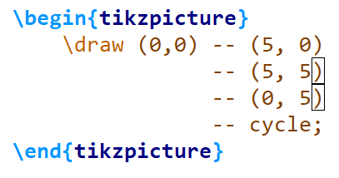

Draw A Rectangle

Slide 10
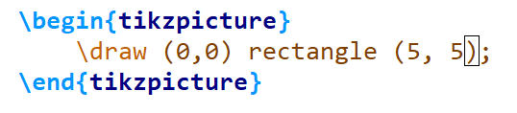
Rectangle Path

Slide 11



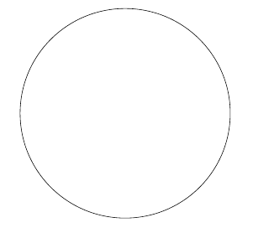
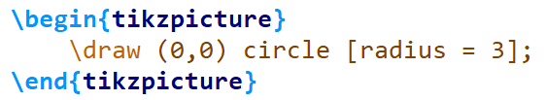
Circle Path

Slide 12




Like, Comment, and Subscribe to the Channel

